Slide 1


MapML implementations in
MapServer, GDAL and OGR
Daniel Morissette, Mapgears
September 30, 2020
W3C/OGC Joint Workshop Series on Maps for the Web
w3.org/2020/maps/

Slide 2

MapML in MapServer, GDAL and OGR
mapserver.org
gdal.org
osgeo.org

Slide 3
MapML in MapServer
MapServer RFC-123: https://www.mapserver.org/development/rfc/ms-rfc-123.html
Planned for inclusion in MapServer 8.0 release
Github source fork: https://github.com/dmorissette/mapserver/tree/rfc123-mapml

Slide 4
MapML in MapServer
Requires a WMS-enabled mapfile
Entry point = vendor-specific WMS GetMapML request
The rest is automagically handled by MapServer and the polyfill viewer
http://example.com/cgi-bin/mapserv?map=... &service=WMS&request=GetMapML &layer=<wms_layer_name>
&projection=<mapml_projection_code>

Slide 5
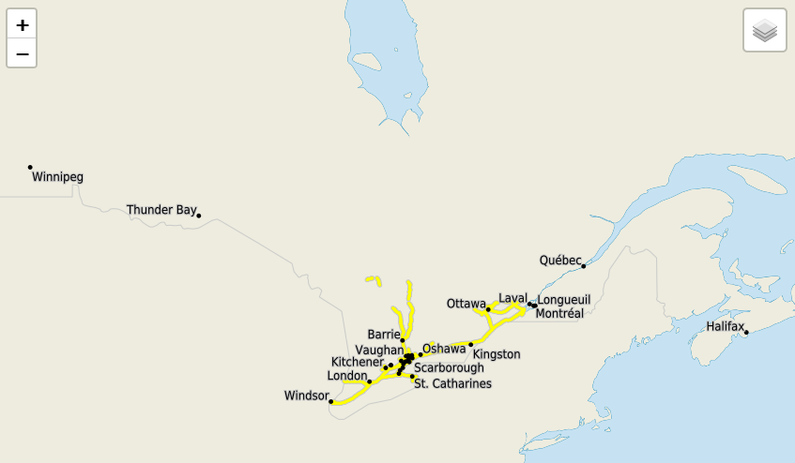
MapML in MapServer
Simple WMS Map Layer Example:
<body>
<map is="web-map" projection="OSMTILE" zoom="5" lat="45" lon="-80" controls>
<layer- label="My WMS" src="http://example.com/cgi-bin/mapserv?map=...&service=WMS&request=GetMapML&layer=...&projection=OSMTILE" checked></layer->
</map>
</body>
http://msdev.mapgears.com/mapml/demos/mapserver-canvec-osmtile.html

Slide 6
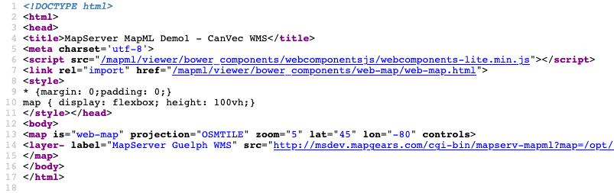
MapML in MapServer

Slide 7
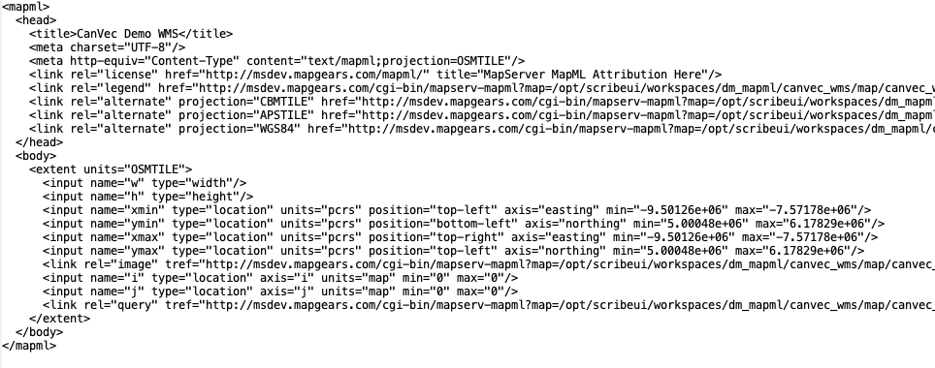
MapML in MapServer
GetMapML Response = <mapml> document with WMS URL references (<link rel=image … >)
http://msdev.mapgears.com/cgi-bin/mapserv-mapml?map=/opt/scribeui/workspaces/dm_mapml/canvec_wms/map/canvec_wms.map&request=GetMapML&layer=canvec_wms&projection=OSMTILE

Slide 8
MapML in MapServer
Multiple MapML <link rel=… > modes
Map Draws:
<link rel=image … > pointing to full page WMS requests
<link rel=tile … > pointing to tiled WMS requests
<link rel=tile … > pointing to mode=tile mapserv CGI requests
<link rel=features … > pointing to WFS GetFeature (future)
Map Query:
<link rel=query … > pointing to WMS GetFeatureInfo, returns <mapml> features
Leverages the OGR MapML vector feature driver…

Slide 9
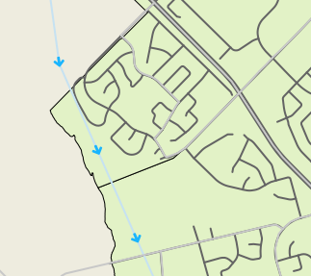
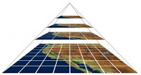
MapML in GDAL/OGR
GDAL
Raster tiles / imagery
OGR
Vector features

Slide 10
MapML driver in OGR
Available in GDAL/OGR v3.1+
https://gdal.org/drivers/vector/mapml.html
Reads and Writes <mapml> vector feature sets

Slide 11
MapML driver in OGR
Usage example:
ogr2ogr -f "MapML" places.mapml place_0.shp
-sql "select pname_en, pop_estim, capital_en
from place_0 where pop_estim > 100000"
-dsco "HEAD=<title>Populated Places</title> »
Or export to MapML from your OGR-enabled GIS software

Slide 12
MapML in gdal2tiles.py
Available in GDAL/OGR v3.1.3+
Adds MapML output support to gdal2tile: https://gdal.org/programs/gdal2tiles.html#mapml-options
Takes a raster file as input and generates a directory with a tile pyramid and <mapml> file

Slide 13
MapML in gdal2tiles
Usage example:
gdal2tiles.py --zoom=16-18 -w mapml -p APSTILE --url "https://example.com" input.tif output_folder

Slide 14
MapML in GDAL/OGR
Thanks to Even Rouault for the GDAL and OGR implementations

Slide 15
THANK YOU!
Daniel Morissette
dmorissette@mapgears.com
September 30, 2020
W3C/OGC Joint Workshop Series on Maps for the Web
w3.org/2020/maps/

